Slide 1

Requirements, Constraints, and Engineering Standards
sdmay22-42
Team: Jason Grunklee, Freedom Clark, Animesh Shrouti, Chimzim Ogbondah, Tzu-Chien Liu, and Robert Wedan

Slide 2
Problem Statement
Soil contributes about 20% of the total emission of carbon dioxide into the atmosphere. This happens through soil respiration and results in a reduction of the soil fertility and productivity.
In addition to carbon dioxide, methane is also a large contributor to greenhouse gases. Wetland methane emissions are the largest source of natural and anthropogenic emissions contributing to about one third of the global methane budget.
Our project attempts to design a robotic sensing system that will measure greenhouse gas emissions, with a focus on carbon dioxide and methane emissions, in wetland soil.

Slide 3
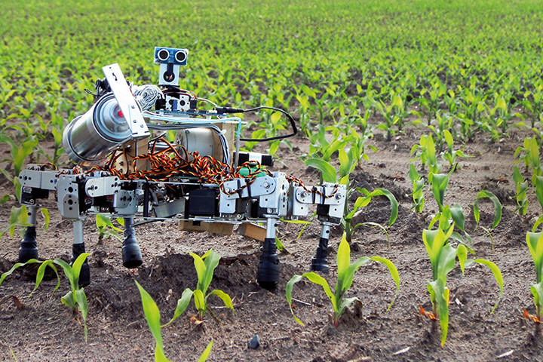
Problem Statement
Robotic sensing systems for greenhouse gas emissions presented in the problem statement currently exist in the world but most are large and very expensive. Our goal is to create a functional copy on a smaller scale and a much stricter budget.

Slide 4
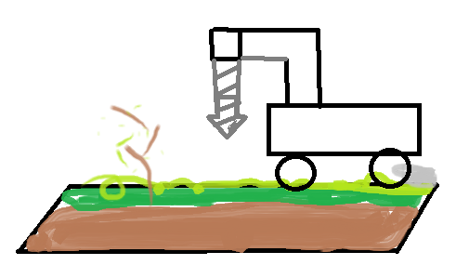
Our Solution
Modify a pre-existing robot to traverse different terrain
Sensing apparatus that collects data from the soil
Communicate with the user for navigation and data delivery
Navigate using GPS on on a predetermined path to find its next test location
The process is replicated for each test location

Slide 5
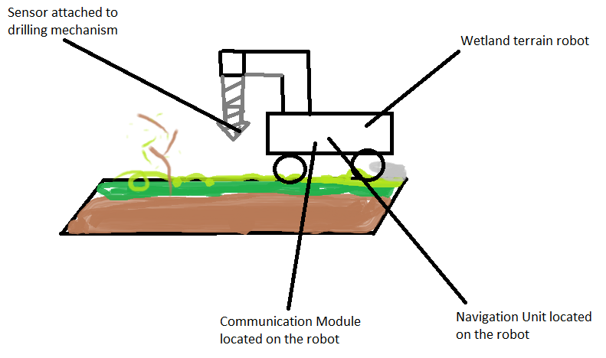
Our Solution
The robotic sensing system for greenhouse gas emissions consists of four components: a robot, a sensing attachment, a navigation unit, and a communication module. Each component presents different requirements and constraints.

Slide 6
Functional Requirements
The robot must be able to traverse wetland conditions which involves plant life and bumpy terrain that is sometimes wet
The robot must be able to carry the weight of the sensing attachment
The robot must be able to withstand the torque of the drilling so that it will not slip on the terrain
The sensing attachment must be able to drill into the soil and collect data from under the ground
The sensing attachment must be able to be carried by the selected robot
The sensing attachment must be able to read carbon dioxide in the soil
The sensing attachment must have a usb interface
The navigation unit must be able to communicate with the robot and move it on a set path using GPS
The communication module must be able to send the data from the sensor to the user for manipulation

Slide 7
Non-Functional Requirements
The user interface must be accessible by the customer and easy to interpret
Best coding practices are used for easy future implementation and design change
The user will be able to designate a unique path for the robot
Design and testing process should be well documented for future handoffs
The robot should be able to reliability repeat its measurement process

Slide 8
Constraints
The entire project must stay under the allotted budget of $3,000
The project needs to be completed in 1200 person hours (across two semesters)
The sensing attachment must be able to detect 400 parts per million of CO2 within the soil
Robot development should begin at the latest the start of semester two
The artificial testing environment shall be within the ISU research farm with limited availability

Slide 9
Engineering Standards
Standard
Justification
7.8 IEEE Code of Ethics | The code of ethics lays out a clear set of values, rules, and guidelines to follow to promote team cohesiveness
IEEE Standard P260.1 | This standard covers letter symbols and units of measurements that will be used in this project
IEEE Standard P802.16 | This standard covers acceptable channels to carry data across and best practices for good and bad connections
IEEE Standard P802.11 | This standard covers protocols on how to communicate between devices
IEEE Standard 1625-2008 | This standard covers the requirements for how to recharge batteries and transmitting data about the battery

Slide 10
Intended Users and Uses
This project targets the lack of affordable robotic sensing systems for greenhouse gasses. This directly benefits researchers in the field that are in need of a more efficient and affordable way to collect data in the field. The research they conduct will help us gain a better understanding of our environment which indirectly helps everyone on Earth.
This project will likely interest anyone that is invested in the environment or is involved in environmental research. The robotic sensing system may be used to test for greenhouse gasses when a person is unable to make it to the location themselves.
On a very large scale there could be many of these robots that can collect samples in a variety of different locations at the same time

Slide 11
Bibliography
Director of the National Centre for Precision Farming (NCPF) and Head of Engineering at Harper Adams University. “The Farm of the Future.” Cropscience, https://www.cropscience.bayer.com/innovations/data-science/a/ripe-robots.
“IEEE SA.” Standards, https://standards.ieee.org/standard/index.html?utm_source=mm_link&utm_campaign=find&utm_medium=std&utm_term=find+standards.

